Slide 1
Web Review and Next Steps
Overview
In this lesson, students will review the Web Development unit and explore paths for continued development.
Duration 120 minutes
Learning Objectives
In this lesson, students will:
Review Web Development concepts in Python
Explore paths for continued development in Web Development

Slide 2
Pre-Class Materials and Preparation
For remote classrooms: Virtual breakout rooms and Slack may be needed to facilitate the partner exercise and discussions. As you plan for your lesson:
Consider how you’ll create pairs for the partner exercise (randomly, or with pre-assigned partners).
Determine how (if at all) exercise timing may need to be adjusted.
For helpful tips, keep an eye out for the For remote classrooms tag in the speaker notes.
Prepare screenshots and answers to exercises in advance so that they can be easily shared in Slack during your lecture.

Slide 3
Suggested Agenda
Time | Activity
0:00–1:30 | Web Development Lab Solution(s)
1:30–2:00 | Web Development Next Steps
0:50–1:00 | Break
1:00–1:50 | Evaluating APIs
1:50–2:00 | Wrapping Up, Q&A, and Exit Ticket Completion

Slide 4
Web Development Review and Next Steps

Slide 5
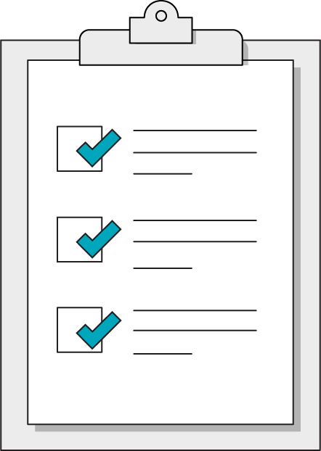
Today’s Learning Objectives
In this lesson, you will:
Review Web Development concepts in Python
Explore paths for continued development in Web Development
‹#› | © 2020 General Assembly
Notes:
Purpose: Set expectations for the lesson.
For remote classrooms:
Capture a screenshot of this slide and drop it in the class Slack channel.

Slide 6
Web Development Review
Web Development Review
Notes:
Duration: 15 minutes

Slide 7
Web Development Unit Lab Presentations and Review
90 minutes
Let's walk through solutions for the web development lab with a guided coding session.
Notes:
Take any questions about the Web Development Unit Lab while coding through solution code. Be sure to prompt students for questions and ideas at each step of the lab: make this interactive, not a one-way performance!

Slide 8
Reflective Review of Web Development
Rate your confidence in the following statements so we can review concepts as necessary:
I understand the role of APIs in Web Development
I can find and use an API to access specific types of data
I can parse the complex data structures that are returned from APIs
I can format an API request with query parameters
I can create a basic Flask application handling basic HTTP requests
I can describe the seven RESTful routes in a Flask application
I can implement index and show routes in a Flask API or template-based web application
Notes:
Ask students to rate their confidence on a scale of 1-5, then take questions on the topics that get the lowest overall ratings.

Slide 9
Next Steps in Web Development
Web Development Review
Notes:
Duration: 10 minutes

Slide 10
Front-End Web Development
We got a crash course in HTML to understand the concept of templates and creating accessible user interfaces, but there's a lot more to learn before we can create attractive, user-friendly web applications:
HTML Forms to create HTTP requests from a user-friendly web page
CSS and CSS Frameworks to style applications
JavaScript to create dynamic web pages that respond to user actions

Slide 11
Persistent Data Storage in Flask
While .csv files provide a convenient, accessible way to manage information, they're no substitute for a properly managed, permanent database such as a SQL database. Consider the following next-steps for Flask applications:
Connect with SQL databases using a library such as SQLAlchemy
Implement Users with encrypted passwords and access restrictions
Utilize sessions to allow users to log-in and maintain application state
Create relational databases that connect tables together
Access cloud-based data storage solutions

Slide 12
Opinionated Web Development Frameworks
Once you understand the concepts of CRUD operations and RESTful routes, you'll begin to notice that most web applications follow similar patterns to serve similar needs.
Flask is a very do-it-yourself library that requires us to set things up ourselves, while Django is a popular alternative that can create robust web applications with plug-and-play solutions to common application needs.
The Djangobook.com and official Django documentation are great sources to start learning to create full applications in the Django way.

Slide 13
Intermediate API Development
Our Flask applications aren't quite as complex or customizable as the APIs we encounter in the wild. Think about how you would add the following features to your Flask APIs:
Query parameters to help filter and search for results
Implement API keys (stored in a database) to restrict and monitor requests
Paginate index results instead of dumping the entire collection at once

Slide 14
Wrapping Up
Web Development Review
Notes:
Duration: 10 minutes

Slide 15

Don’t Forget: Exit Tickets!

